Slide 1
DevSecOps

Slide 2
Objectives
At the end of this session, you will be able to:
    What is DevSecOps
    Importance of DevSecOps
    Difference between Agile ,DevOps and DevSecOps

Slide 3
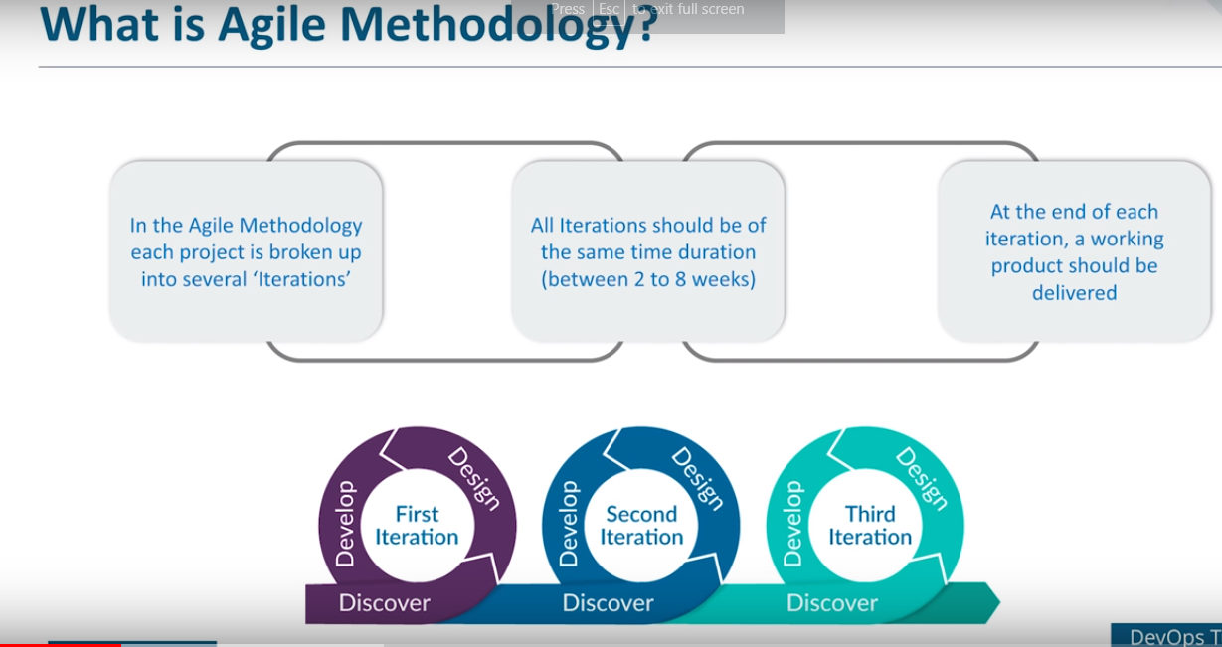

Slide 4
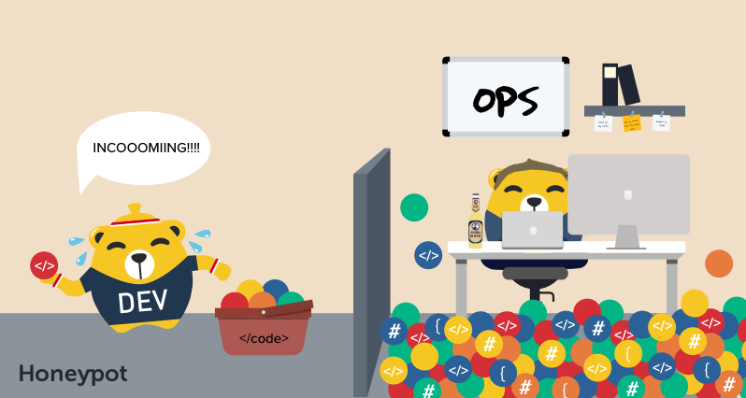
Challenges in Agile

Slide 5
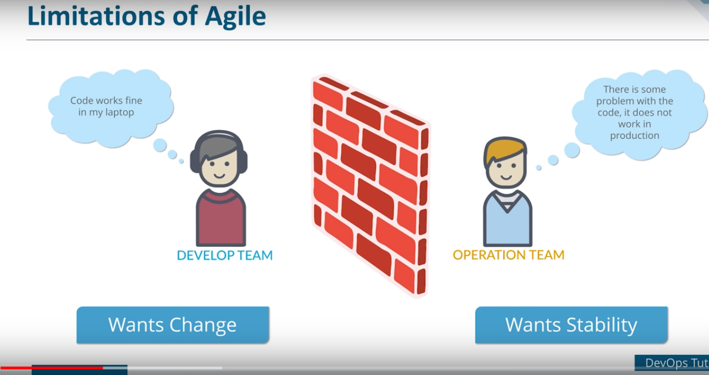

Slide 6
Challenges in Agile
Development and operations team work in isolations
In Agile, Operations team has no clue on the progress of the Development team. So, operations team develops an IT infrastructure deployment and monitoring plan as per their understanding.
Manual code deployment leads to human errors in production
organizations would divide work and communicate internally, but hardly ever between teams. When one team completed their tasks, they would pass it to the next team, throwing it over the proverbial “wall”, assuming that their job was done and they had nothing else to do with the project.

Slide 7
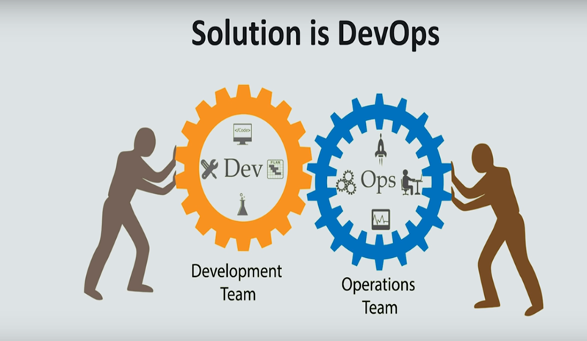

Slide 8
DevOps
DevOps is a culture which promotes collaboration between Development and Operations Team to deploy code to production faster in an automated & repeatable way.
In the DevOps process operation team fully aware of the progress of developer. The deployment and monitoring planning is accurate.
DevOps offers Maintainability, Predictability, Greater quality cost efficiency and time to market.

Slide 9
DevOps ----Continued
Agile process focuses on functional and non-functional readiness while DevOps focuses on that IT infrastructure aspects.
DevOps life cycle includes Development, Testing, Integration, Deployment, and Monitoring.
DevOps lifecycle must be automated to satisfy CI/CD concept .
DevOps helps organizations in shifting their code deployment cycles to weeks and months instead of years.

Slide 10
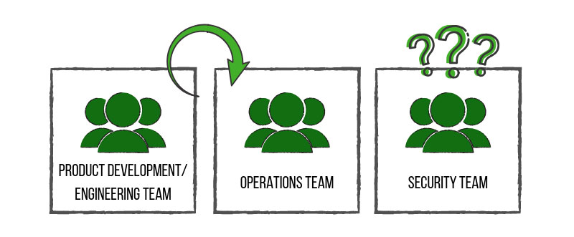
Challenges in DevOps
DevOps Teams Neglect Security.
The security team was often clued in at the end of the project, much like an afterthought. Security Teams Struggle to Keep Up With the Pace of DevOps.
This lack of communication caused confusion and conflict between teams, slowed down production time and introduced more vulnerable products to the consumer. This, of course, consequently affected the path of value for companies.

Slide 11
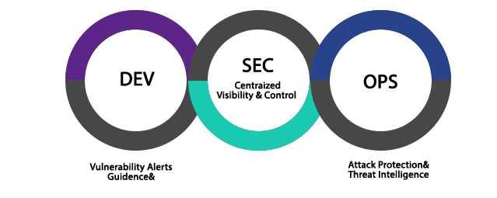
What is DevSecOps?
DevSecOps is the evolution of the DevOps philosophy.
The advent of DevSecOps placed security into the big picture and allowed all involved teams to work together from development to end product – a stronger, more efficient and more resilient end product.
It is a concept that injects security into the software development lifecycle. If DevOps is about increasing the level of communication between development and operations, then DevSecOps is about inviting security into the conversation
Now with DevSecOps concept of CI/CD/CS come into picture .

Slide 12
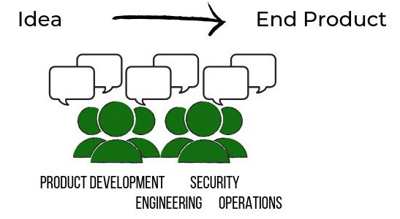
What we want to achieve through DevSecOps?

Slide 13
What are the benefits of DevSecOps?
Costs are reduced by uncovering and fixing security issues further left in the development lifecycle versus in production environments.
Speed of product delivery is increased by incorporating automated security tests versus adding security testing at the end of lifecycle.
Increased transparency and team collaboration leads to faster detection and recovery of threats.
Implementing immutable infrastructure improves overall security by reducing vulnerabilities, increasing automation, and encourages organizations to move to the cloud.

Slide 14
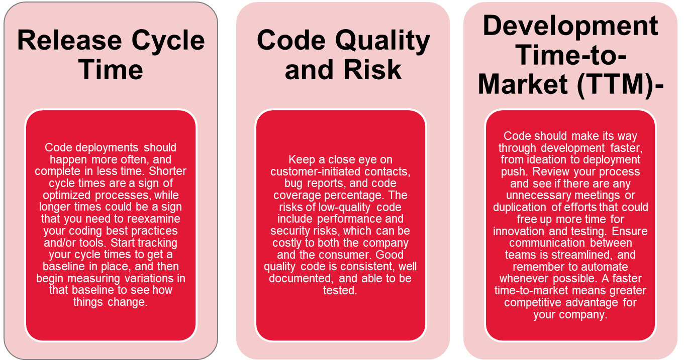
Key Performance Indicators (KPIs) of DevSecOps

Slide 15
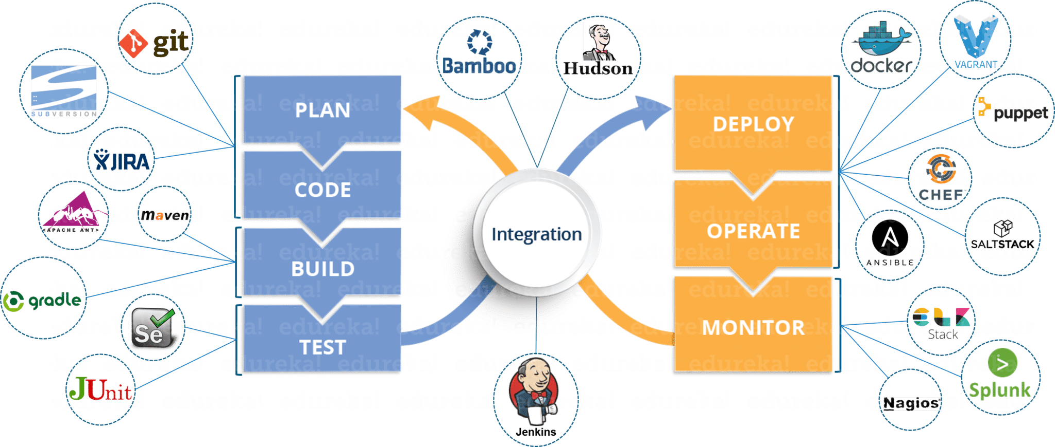
DevOps Tools and its integration

Slide 16
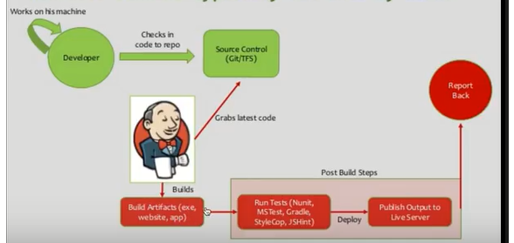
Sample DevOps Project

Slide 17
Summary
In this session, we have covered,
    How the DevOps and DevSecOps evolved
    Security of application is now in DevSecOps.
    DevSecOps is about CI/CD/CS.
    App Security is the responsibility of every one .

Slide 18
Thank you

